Slide 1

Transformations in Computer Graphics

Slide 2
Introduction to Transformations
Transformation is the application of some mathematical rules to an object or a pixel to bring about some change to it.
This change can be a displacement of an object from one point to another or a change in its size or shape.
Two types of transformations are
Solid body transformations
Affine transformations

Slide 3
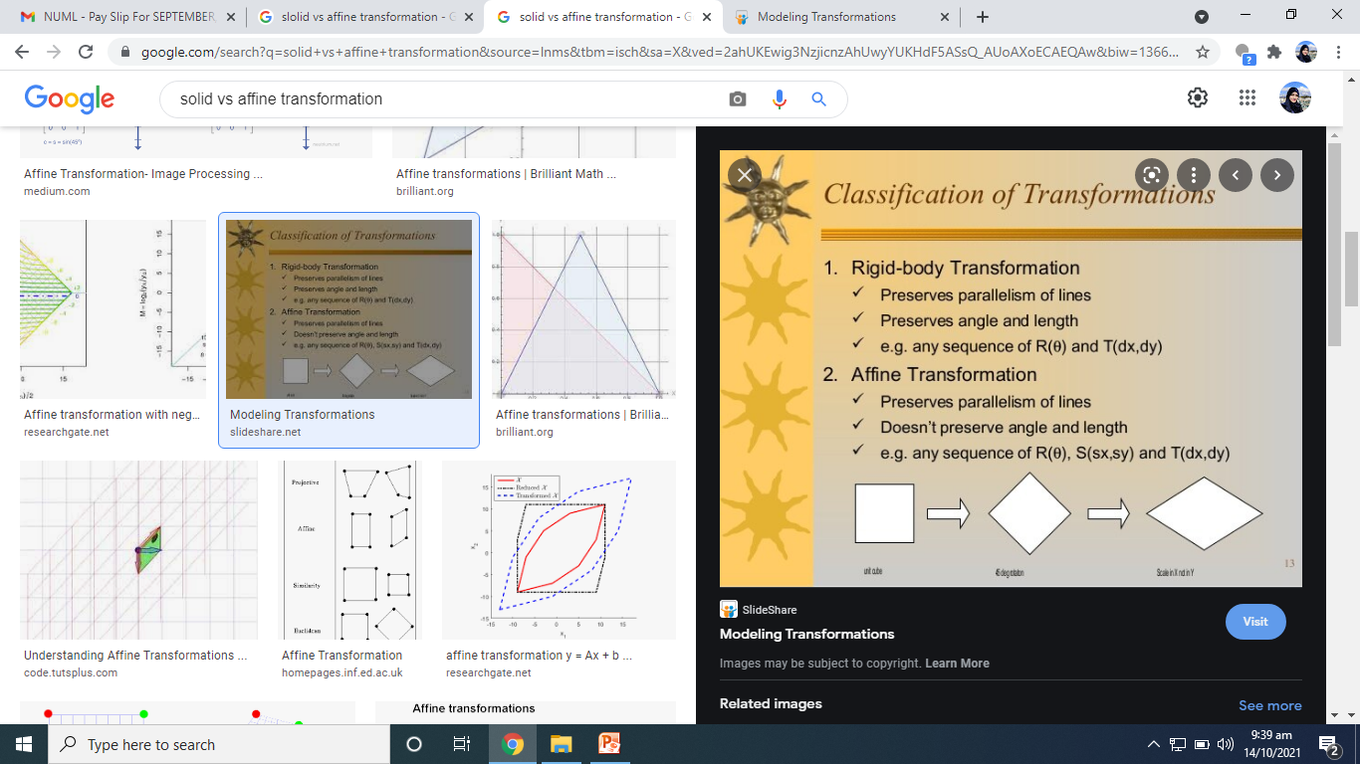

Slide 4
Affine Transformations
Translation – Move object
Scaling – Resize object
Rotation – Turn object
Reflection – Mirror object
Shearing – Slant object

Slide 5
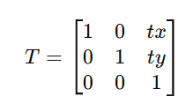
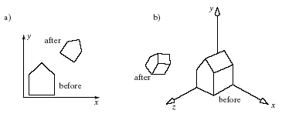
Translation
Moves an object from one position to another.
Formula (2D): (x′,y′)=(x+tx,y+ty)
Formula (3D): (x′,y′,z′)=(x+tx,y+ty,z+tz)

Slide 6
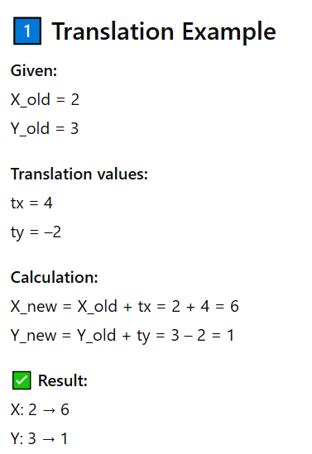
Translation (Move Object)

Slide 7
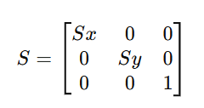
Scaling
Changes the size of an object
Formula (2D): (x′,y′)=(x⋅sx,y⋅sy)
Formula (3D): (x′,y′,z′)=(x⋅sx,y⋅sy,z⋅sz)

Slide 8
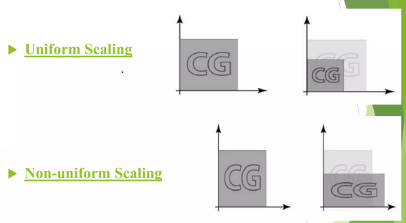
Types of Scaling
Uniform vs Non-uniform scaling
Uniform Scaling-> x and y are same
Non uniform scaling -> x and y are not same

Slide 9
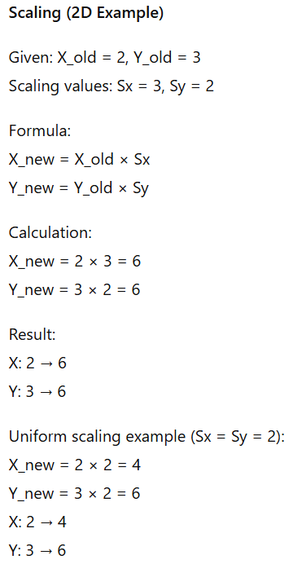

Slide 10
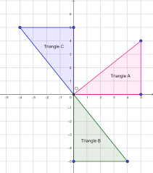
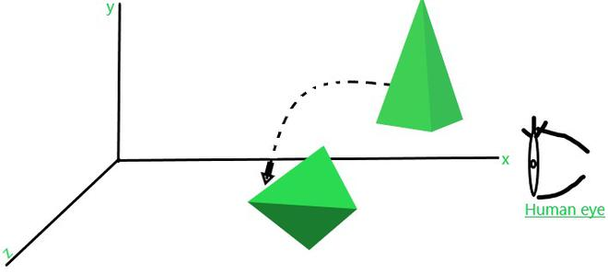
Rotation
Rotates object about a point (2D) or axis (3D)
2D Formula (rotation about origin):
2D:
x′=xcos⁡θ−ysin⁡θ,
y′=xsin⁡θ+ycos⁡θx’
3D: Rotate about X, Y, or Z axis

Slide 11
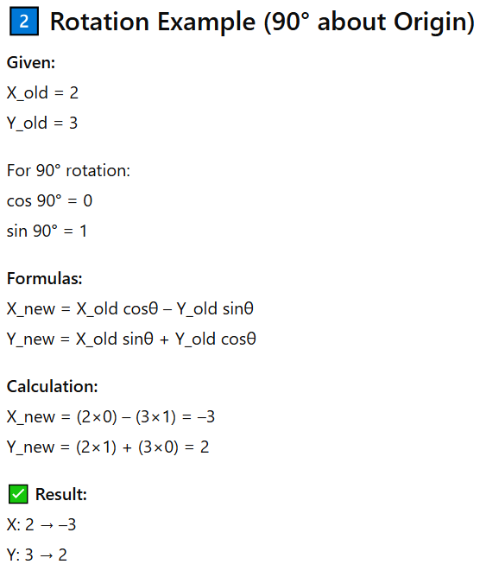
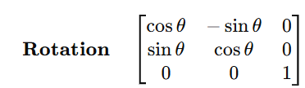

Slide 12
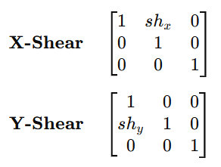
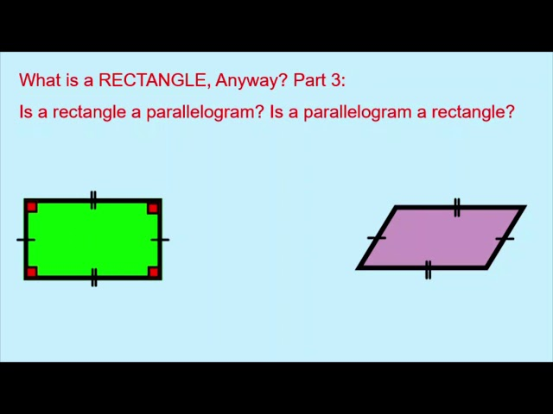
Shearing
Slants the shape along X or Y axis
Formula (2D):
X-shear: x′=x+shx⋅y
shear: y′=y+shy⋅x
Rectangle skewed to form a parallelogram

Slide 13
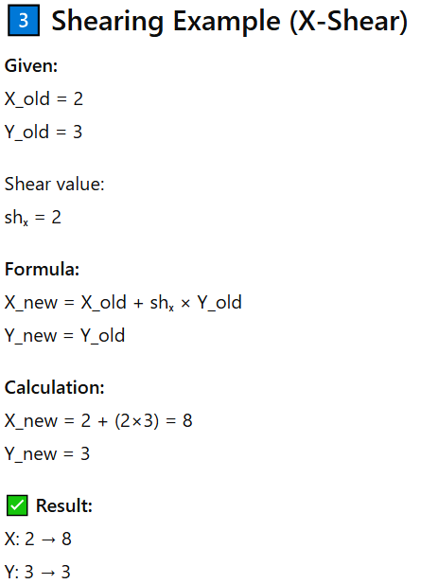
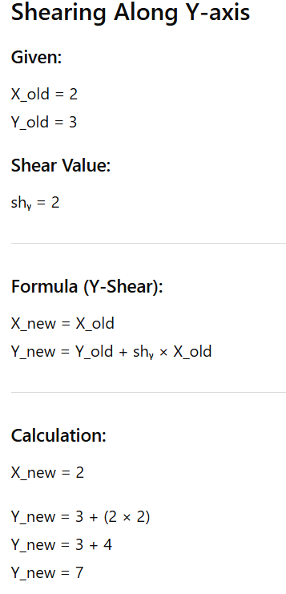
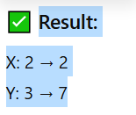

Slide 14
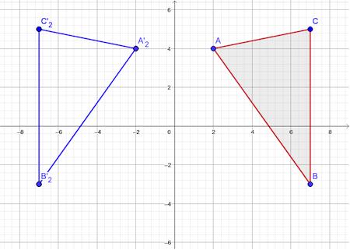
Reflection
Mirror image of object across an axis/plane
Common axes: X-axis, Y-axis, origin
3D: Reflection across XY, YZ, or ZX plane

Slide 15
COMPOSING AFFINE TRANSFORMATIONS
Combination of two or more transformations
Applied one after another on the same object
Order of transformations matters
Implemented using matrix multiplication

Slide 16
Example:
translate by (3, - 4)
then rotate by 30º
then scale by (2, - 1)

Slide 17
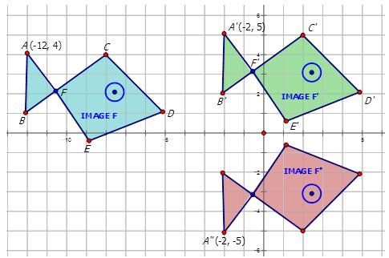

Slide 18
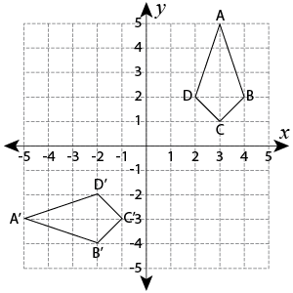

Slide 19
Combining Translation & Rotation

Slide 20
Translate Coordinate Frame
Translate (3,3)
Scale(2,2)

Slide 21
Example (cont’d)
If you think of transformations as
moving the local coordinate frame.
o
Translate (5,0)
2) Rotate ( )
60
o
60
(5,0)
Exact the opposite order compared to the
previous slide!!

Slide 22
Example (cont’d)
(0,0)
(5,0)

